Slide 1
Software Size Estimation
BSCS – FALL 2017

Slide 2
A software engineer collects measure and develops metrics so that indicators will be obtained •
An indicator provides insight that enables the project manager or software engineers to adjust the process, the project, or the product to make things better

Slide 3
Software Metrics Metrics (cont d) (cont’d)
• The five essential, fundamental fundamental metrics: metrics: –
Size (LOC, etc.) –
Cost (in dollars) –
Duration (in months)
– Effort (in person‐month) –
Quality (number of faults detected)

Slide 4
LOC‐based Estimation
The problems of lines of code (LOC) – Different languages lead to different lengths of code
It is not clear how to count lines of code
A report, screen, or GUI generator can generate thousands of lines of code in minutes
Depending Depending on the application application, the complexity complexity of code is different

Slide 5
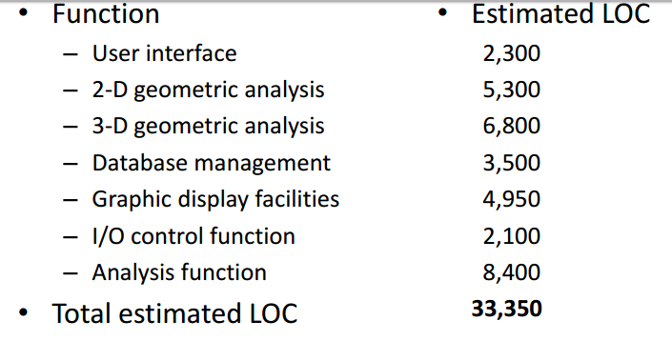
LOC‐based Estimation Estimation ‐ Example

Slide 6
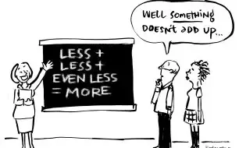
How many lines of code per day?
I recall a small project where I wrote about 1000 lines on the first day. On the second day, found a library that solved most of the problem for me, so I was able to cut the solution down to about 50 lines of code.
On the third day, found a second library that solved virtually the exact problem, so it was cut down again to 2 lines of code. 2 lines of code in 3 days.

Slide 7
And
I spent about four or five hours triaging incoming issues from yesterday which were generated out of our ongoing formal system test.
I spent an hour talking to engineers who needed guidance interpreting tests and results and having two meetings.
I spent two hours finding a bug stopping our product starting correctly in a very small range of conditions, in a part of the code I had never touched before.
I spent five minutes writing two lines of code to fix it and a further 30 minutes writing a test plan for it, checking it back in to subversion, monitoring the cascade of automated tests, updating and resolving the ticket.

Slide 8
And
In the last three weeks, I’ve written a negative 7,000 lines of Oracle PL/SQL. That’s right NEGATIVE 7,000 lines. I took a 10,000 line package and stripped out everything that’s irrelevant for this implementation. I also nuked procedures which will be rewritten by another developer in a separate package because we are changing the history table formats (YAY!).
Of the remaining 2 to 3,000 lines, I’m having to read each line to see if I need to modify them further.
If all goes well, we can use these new packages at other clients.

Slide 9
Man hours and man days
6 hours = 1 day 1 person @ 6 hours = 6 man-hours = 1 man-day 2 people @ 6 hours = 12 man-hours = 2 man-days Adjust hours per day as appropriate, but remember that the only way to get 8 hours production is to have a work day that is longer than 8 hours and that going past about 10 working hours per day or past about 50 hours per week doesn't gain you much, if anything.

Slide 10
You need to estimate the software effort first. Then find how many people will work on the same to deliver the project. Then and only then the man-days will have a meaning. Example One Man Day = 8 hours Estimated Software Effort = 1000 hours Man-days for the software = 1000/8 = 125 Man days For a one man team the Mandays are 125/1 = 125 Man days This means one person working for 125 working days can finish the software. For a two man team the Mandays are 125/2 = 62.5 Mandays

Slide 11
Average productivity based on historical data
– 620 LOC/pm
– $8,000 per month
‐> $12.91/LOC

Slide 12
If the estimated project is 33,200 LOC, – then the total estimated project cost is $______ and – the estimated effort is __ person‐month

Slide 13
Source lines of code (SLOC or LOC)
is a software metric used to measure the size of a software program by counting the number of lines in the text of the program's source code.
SLOC is typically used to predict the amount of effort that will be required to develop a program, as well as to estimate programming productivity or effort once the software is produced.

Slide 14
There are two major types of SLOC measures: physical SLOC (LOC) and logical SLOC (LLOC). Specific definitions of these two measures vary, but the most common definition of physical
SLOC is a count of lines in the text of the program's source code including comment lines. Blank lines are also included unless the lines of code in a section consists of more than 25% blank lines. In this case blank lines in excess of 25% are not counted toward lines of code.

Slide 15
Example
Consider this snippet of C code as an example of the ambiguity encountered when determining SLOC:
for (i = 0; i < 100; i += 1) printf("hello"); /* How many lines of code is this? */

Slide 16
Depending on the programmer and/or coding standards, the above "line of code" could be written on many separate lines:
for (i = 0; i < 100; i += 1)
{
printf("hello");
} /* Now how many lines of code is this? */

Slide 17
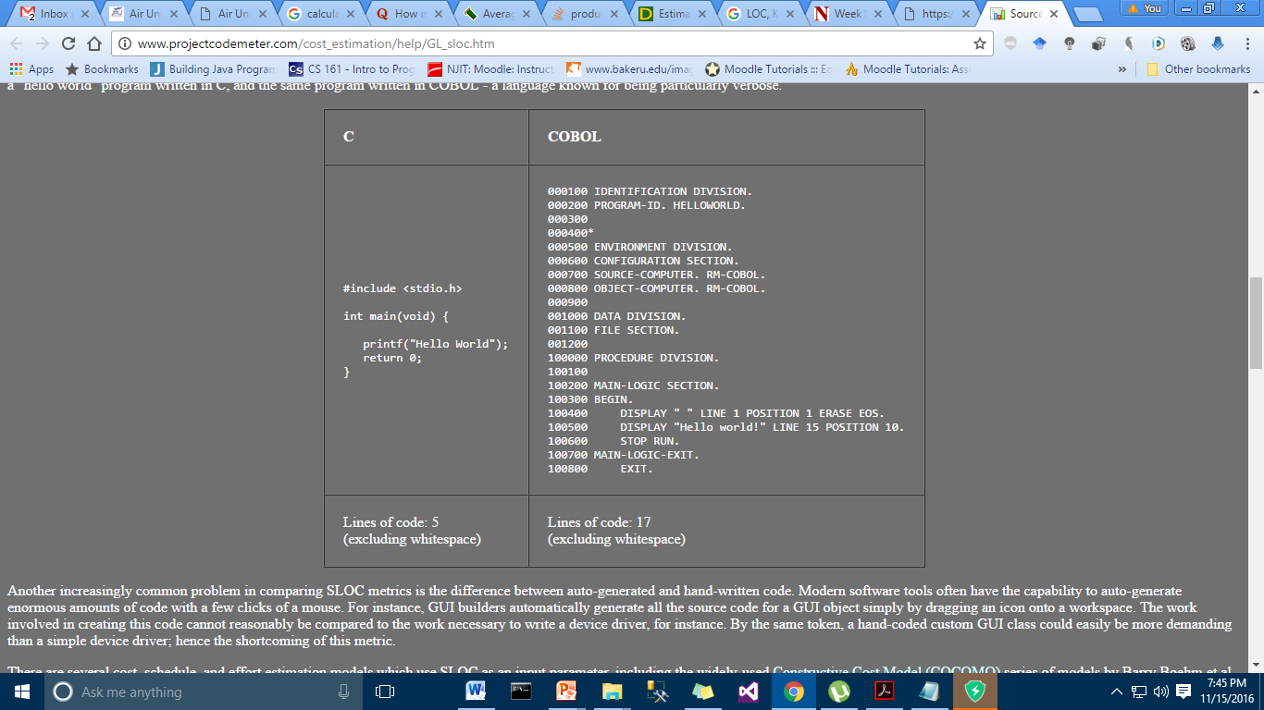

Slide 18
Person-months
Most software cost estimates assume cost = effort
Effort = man-month, i.e., a person’s work for a month
Usually ignores cost of hardware or cost of maintenance
Fred Brooks, The Mythical Man-Month, 1975:
“Cost does indeed vary as the product of the number of men and the number of months. Progress does not. Hence the man-month as a unit for measuring the size of a job is a dangerous and deceptive myth. It implies men and months are interchangeable.”
“Men and months are interchangeable commodities only when a task can be partitioned among many workers with no communication among them. This is true of reaping wheat or picking cotton; it is not even approximately true of systems programming.”
“Adding manpower to a late project makes it later.”

Slide 19
LOC/KLOC
LOC: lines of code
KLOC: kilo lines of code, or (lines of code) / 1000
Still regarded as most accurate way to measure labor costs
What are some uncertainties about measuring LOC?
Should comment lines count? Or blank lines for formatting?
How do we compare lines of assembly language vs. high-level language like C++ or Java?
How do you know how many LOC the system will contain when it’s not implemented or even designed yet?
How do you account for reuse of code?

Slide 20
HOW MANY LOCS
I am the only full-time dev at our company and have written 500,000 lines of OCaml and F# code over the past 7 years, which equates to about 200 lines of code per day. However, the vast majority of that code is tutorial examples consisting of hundreds of separate projects each a few hundred lines long. Also, there is a lot of duplication between the OCaml and the F#. We are not maintaining any in-house code bases larger than 50kLOC.

Slide 21
Mythical man month 10 lines per developer day

Slide 22
since I started at Google, I have written 33,917 lines of code (this is an absolute value; both additions and deletions count towards it. I have deleted 12,313 lines of code). I have been an employee at Google for 340 days. Let's say that 2/7th of those days were weekends, and between company holidays and vacation, I have taken an additional 15 days off past that. Assuming I worked 8 hours a day, that means I have worked 1822 hours for Google. Dividing, we find that I have written 18.6 lines of code per hour.

Slide 23
Counting SLOC
To count the SLOC the following must be considered:
→ The count includes:
- The SLOC delivered to client.
- The SLOC written only by the development team are counted
- The declaration statements are counted as source lines of code
→ The count excludes:
- The code created by application generators.
- The comments inserted to improve the readability of program.
Once, you get the numbers of line of code of SLOC, you can estimate or calculate the
total effort and cost to complete the given project.

Slide 24
Example: -
Assume estimated lines of code of a system is: 33,200 LOC –
Average productivity for system of this type is: 620 LOC/person-month –
There are 6 developers - Labor rate is: $ 800 per person-month ?
Calculate the total effort and cost required to complete the above project.

Slide 25
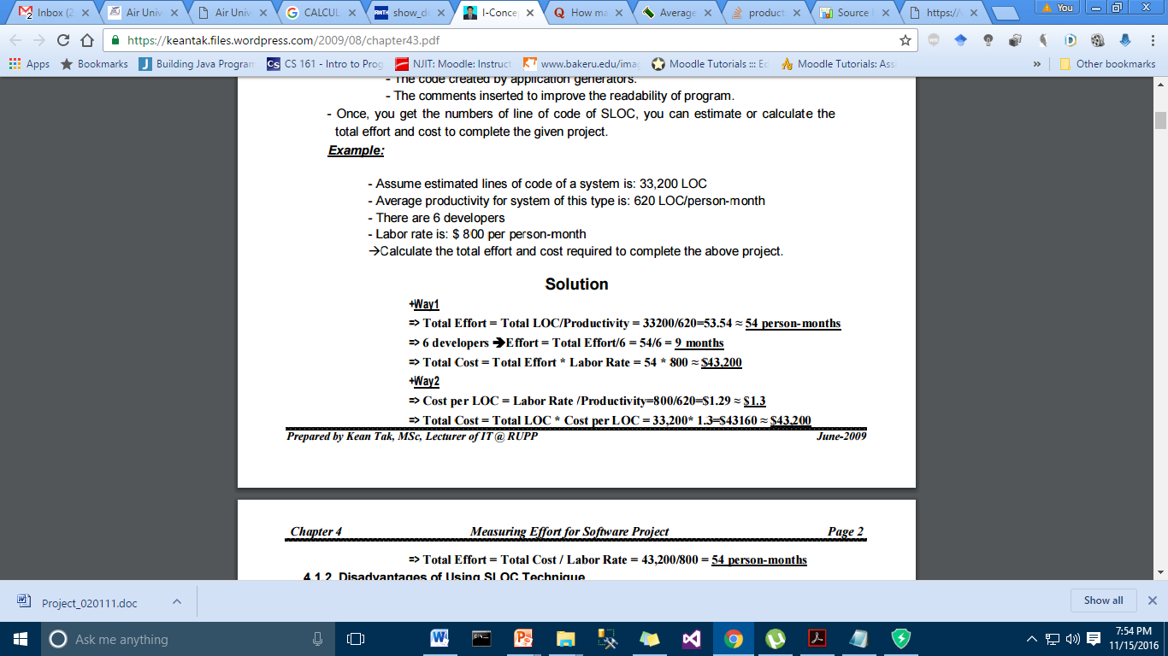

Slide 26
